Slide 1

Credit Wise – Loan Approval Prediction
Team Members
Maharudra Patil
Yash Umdale
Kartik Swami
Created By AI

Slide 2

01
Introduction & Project Overview
Contents
02
Data and Methodology
03
Exploratory Data Analysis and Observations
04
Model Building and Evaluation
05
Conclusion and Future Scope

Slide 3

Project Objective and Context
Banking Process Challenge
Core Project Goal
Manual loan approval is slow and prone to errors, creating inefficiencies in financial institutions. Machine learning offers a pathway to enhance speed and accuracy in this critical process.
The primary objective is to build a predictive model for loan approval. This aims to reduce financial risk, enable automated assessments, and provide consistent, data-driven decisions for banks.

Slide 4


Problem Statement and Key Goals
Predictive Problem Definition
The core problem is to predict whether a loan application will be approved or denied. This prediction is based on key applicant data points such as income, credit history, and loan amount.
Strategic Goals
Key goals include reducing financial risk for lenders, providing consistent and objective decision-making, and enabling a more efficient, automated financial assessment workflow.

Slide 5
Dataset Description and Sources
01
02
Data Source and Structure
Methodological Framework
The project utilizes the Kaggle Loan Dataset, a structured dataset containing features like Income, Loan Amount, Credit History, and Employment status. The target variable is Loan_Status.
The methodology follows a clear pipeline: Data Collection → Preprocessing → Exploratory Data Analysis (EDA) → Model Building → Evaluation → Insights.

Slide 6

Data Preprocessing Steps
Data Cleaning and Preparation
The preprocessing stage involved handling missing values, removing inconsistencies, and encoding categorical variables. Feature scaling was also applied to prepare the dataset for effective modeling.

Slide 7
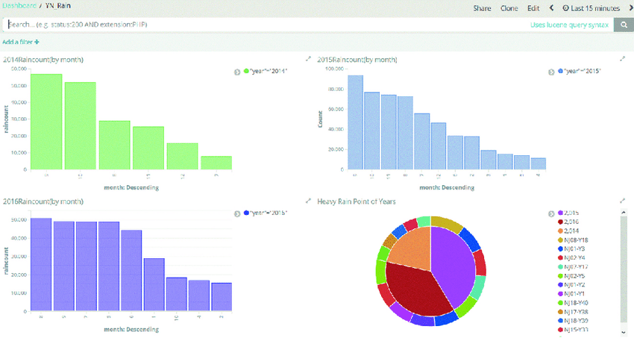
Analysis and Visualization
EDA Process and Purpose
Exploratory Data Analysis involved analyzing data distribution and creating key visualizations, including a loan approval distribution chart and a correlation heatmap. The purpose was to identify patterns and understand feature importance.

Slide 8

Key Insights from Data
Primary Predictive Factors
Credit history emerged as the strongest predictor for loan approval. Higher income levels were directly correlated with higher approval chances, and financial features dominated the decision-making process.
Additional Feature Influence
While some features showed moderate influence, the analysis confirmed that financial stability and creditworthiness are the most critical factors in determining loan outcomes.

Slide 9
Model Selection and Rationale
Classification Models Used
01
The project employed several models suitable for classification: Logistic Regression, K-Nearest Neighbors (KNN), and Naive Bayes. These models were chosen for their interpretability and suitability for the problem.
Model Selection Rationale
02
These models were selected because they are well-suited for classification problems and provide interpretable results, which is crucial for financial decision-making systems.

Slide 10

Model Performance and Best Model
Evaluation Metrics and Results
Model evaluation used metrics like Accuracy, Precision, and a full Classification Report. Results showed Naive Bayes as the best performer, followed by Logistic Regression, with KNN showing lower performance.
Best Model Justification
Naive Bayes was selected as the best model due to its high precision, which reduces false approvals. This makes it ideal for financial systems where minimizing risk is paramount.

Slide 11

Project Insights and Conclusion
Key Takeaways from Analysis
The analysis confirmed that credit history is the most important factor, income strongly affects approval, and overall financial stability significantly improves approval chances.
Project Conclusion
Machine learning can effectively automate the loan approval process, leading to improved efficiency and reliability in banking operations.

Slide 12
Recommendations and Future Work
Future Scope and Enhancements
Immediate Recommendations
Future work includes exploring advanced models like Random Forest and XGBoost, as well as deploying the model on a web platform for real-time data processing.
It is recommended that banks adopt ML systems for loan approval, with a specific focus on enhancing credit analysis capabilities.

Slide 13
Thank you

